Slide 1
5th lecture : Investigation Of Respiratory Diseases
A detailed history
Thorough examination &
Basic haematological &
Biochemical tests
usually indicate the likely diagnosis & differential.
But A number of other investigations are normally required to confirm the diagnosis and/or monitor disease activity.

Slide 2
Imaging
1.‘plain’ chest X-ray
performed on the majority suspected of having chest disease.
A postero-anterior (PA) film:
lung fields
heart
mediastinum
vascular structures & thoracic cage
lateral film, if pathology
behind the heart shadow
deep in the diaphragmatic sulci

Slide 3
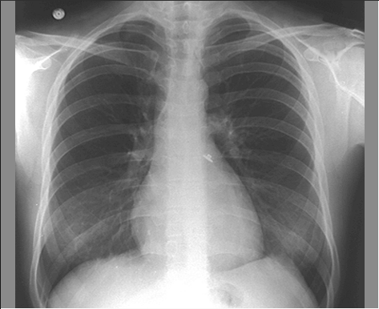
How to interpret a chest X-ray
Name, date, orientation
Films are postero-anterior (PA) unless marked AP.?
Lung fields Equal translucency?
Check horizontal fissure from right hilum to sixth rib at the anterior axillary line
Masses? Consolidation? Cavitation?
Lung apices Check behind the clavicles: Masses? Consolidation? Cavitation?
Trachea Central? (Midway between the clavicular heads) Paratracheal mass? Goitre?
Heart Normal shape? Cardiothoracic ratio ( < half the intrathoracic diameter) Retrocardiac mass?

Slide 4
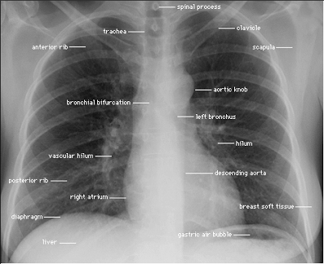
Normal CX-R
Hila Left should be higher than right
Shape? (Should be concave laterally;
if convex, consider mass or lymphadenopathy)
Density?
Diaphragm Right be higher than left
Hyperinflation? (No more than 10 ribs should be visible posteriorly above the diaphragm)
Costophrenic angles
Acute and well defined? (Pleural fluid or thickening, if not)
Soft tissues Breast shadows in females
Chest wall for masses or subcutaneous emphysema
Bones: Ribs, vertebrae, scapulae & clavicles
Any fracture visible at bone margins or lucencies?

Slide 5
Common chest X-ray abnormalities
Pulmonary & pleural shadowing
Consolidation: infection, infarction, inflammation, Broncho-alveolar CA
Lobar collapse: mucus plugging, tumor, compression by lymph nodes
Solitary nodule:
Multiple nodules: miliary tuberculosis (TB), dust inhalation, metastatic , healed varicella pneumonia, rheumatoid disease
Ring shadows: bronchiectasis
Cavitating lesions:
tumour,
abscess,
infarct,
pneumonia (Staphylococcus/Klebsiella),
granulomatosis with polyangiitis

Slide 6
Common chest X-ray abnormalities
Reticular, nodular & reticulo-nodular shadows:
Diffuse parenchymal lung disease, infection
Pleural abnormalities:
fluid, plaques, tumour
Increased translucency
Bullae
Pneumothorax
Oligaemia
Hilar abnormalities
Unilateral hilar: TB, bronchial carcinoma, lymphoma
Bilateral hilar: sarcoid, lymphoma, TB, silicosis
Other
Hiatus hernia • Surgical emphysema

Slide 7
Computed tomography (CT)
detailed images of
pulmonary parenchyma, mediastinum, pleura & bony structures.
position and size of a pulmonary lesion & Detect calcification or cavitation .
routinely, with suspected lung cancer
guided percutaneous needle biopsy.
tumour staging
High-resolution CT (HRCT) (thin sections) :
parenchymal lung disease
bronchiectasis , &
emphysema in assessing type & extent

Slide 8
Assessment of the pulmonary circulation
CT pulmonary angiography (CTPA):the investigation of choice in the
diagnosis of pulmonary TE (confirm the suspected embolism or highlight an alternative diagnosis).
replaced the radioisotope-based ventilation–perfusion scan.
Doppler echocardiographic
assessment of tricuspid regurgitant jets allows accurate non-invasive
measurement of pulmonary artery pressure In pulmonary
hypertension

Slide 9
Positron emission tomography (PET)
(PET) scanners record the ability of malignant tissue to absorb &
metabolize glucose avidly.
The radiotracer is infused and rapidly taken up by malignant tissue, becoming ‘trapped’ in the cell.
PET is useful in the investigation of:
pulmonary nodules
staging mediastina lymph nodes
distal metastatic disease

Slide 10
Ultrasound
Ultrasound is used
Assess the pleural space for pleural fluid, hypoechoic space.
visualization of the diaphragm & solid organs (liver, spleen & kidneys)
allowing safe pleural aspiration, biopsy & intercostal chest drain .
guide needle biopsy of superficial lymph node or chest wall masses
provides useful information on the shape and movement of the diaphragm.

Slide 11
Investigation of pleural disease
Core biopsy of the pleura, guided by either ultrasound or CT, has largely replaced the traditional ‘blind’ method of pleural biopsy using an Abram’s needle.
Thoracoscopy, which involves the insertion of an endoscope through the chest wall, facilitates biopsy under direct vision .

Slide 12
Histopathology & cytology
Histopathological examination of biopsies of pleura, in suspected:
malignancy
interstitial lung disease.
organisms, such as M. tuberculosis, Pneumocystis jirovecii or fungi,
in bronchial washings, brushings or transbronchial biopsies.
Cytological examination of exfoliated cells in pleural fluid or bronchial
brushings and washings, or of fine needle aspirates from lymph
nodes or pulmonary lesions, can support a diagnosis of malignancy .
Differential cell counts in bronchial lavage fluid
may help to distinguish pulmonary changes due to sarcoidosis from
those caused by idiopathic pulmonary fibrosis or pneumonitis

Slide 13
Endoscopic examination
Fibro optic Bronchoscopy:
inspected The trachea & the first 3–4 generations of bronchi
biopsy, bronchial brushings, washings or aspirates can be taken for cytological or bacteriological examination.
(transbronchial biopsies), in sarcoid, hypersensitivity pneumonitis & diffuse malignancy.
Transbronchial needle aspiration (TBNA) to sample mediastinal lymph nodes and to stage lung cancer.
Rigid bronchoscopy:
requires general anaesthesia
reserved for specific situations, such as massive haemoptysis
removal of foreign bodies
Endobronchial laser therapy and endobronchial stenting .

Slide 14
Immunological and serological tests & skin test
The presence of pneumococcal antigen in sputum, blood or urine
Influenza viruses can be detected in throat swab samples .
In blood, high or rising antibody titers to specific organisms ( Legionella, Mycoplasma, Chlamydia or viruses)
early diagnosis of Legionella by urine antigen testing.
Precipitating antibodies
Aspergillus
hypersensitivity pneumonitis .
Total levels of immunoglobulin E (IgE), & levels of IgE directed against specific antigens,in allergy to respiratory disease.
Skin tests
The tuberculin test (tuberculosis).
Skin hypersensitivity tests (allergic diseases)
Kveim test in sarcoidosis

Slide 15
Microbiological investigations
Sputum
pleural fluid
throat swabs
Blood
bronchial washings
aspirates
sample can be examined for bacteria, fungi and viruses ,malignant cells, allergic .
spontaneous
induce expectoration of sputum

Slide 16
Respiratory function testing
Respiratory function tests are used to:
Aid diagnosis,
Assess functional impairment
Monitor treatment
Progression of disease
Airway narrowing, lung volume & gas exchange capacity are quantified & compared with normal values adjusted for age, gender, height and ethnic origin.
In airway narrowing diseases, maximum expiratory flow is limited by:
dynamic compression of small intra thoracic airways, (‘obstructive’ defect).
Extrem Hyperinflation of the chest, loss of elastic recoil due to
parenchymal destruction, as in emphysema.
In contrast, diseases that cause interstitial inflammation and/or fibrosis lead to progressive loss of lung volume (‘restrictive’ defect) with normal expiratory flow rates.

Slide 17
Measurement of airway obstruction
Airway narrowing is assessed by:
a peak flow meter or
a spirometer.
(FEV1) is the volume exhaled in the first second, &
(FVC) is the total volume exhaled.
FEV1 is reduced in airflow obstruction, resulting in FEV1/FVC ratios of less than 70%.
following inhaled short-acting β2- agonists (e.g. salbutamol);
a large improvement in FEV1 and variability in peak flow over time are features of asthma.

Slide 18
Interpret respiratory function test

Slide 19
large airway narrowing
In large airway narrowing (tracheal stenosis or compression)
flow/volume loops are recorded using spirometry.
Which display flow in relation to lung volume (rather than time) during maximum expiration and inspiration, and the pattern of flow reveals the site of airflow obstruction

Slide 20
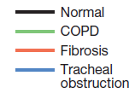
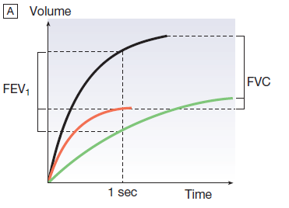
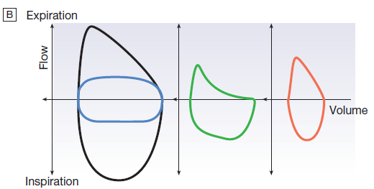
Volum/time
Volume /flow

Slide 21
Arterial blood gases and oximetry
Arterial blood gases:
The measurement of hydrogen ion concentration, PaO2 and PaCO2, & derived bicarbonate concentration in an arterial blood sample , is essential to assess the degree and type of respiratory failure, & for measuring acid– base status.
Interpretation of results is made easier by blood gas diagrams , which indicate whether any acidosis or alkalosis is due to acute or chronic respiratory derangements of PaCO2, or to metabolic causes.

Slide 22
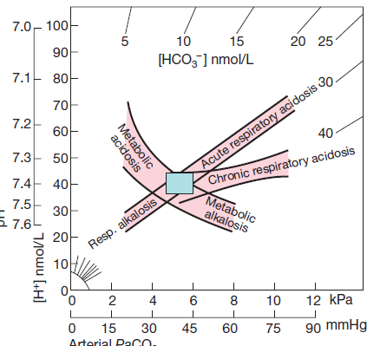
acid–base disorder,
Changes in blood [H+], PaCO2 and plasma [HCO3−] in acid–base disorders.
The rectangle indicates normal limits for [H+] and PaCO2.
The bands represent 95% confidence limits of single disturbances in human blood.
To determine the likely cause of an acid–base disorder, plot the values of [H+] and PaCO2 from an arterial blood gas measurement..
The diagram indicates whether any acidosis or alkalosis results primarily from a respiratory disorder of PaCO2 or from a metabolic derangement.
Adapted from Flenley 1971 – see p. 732.

Slide 23
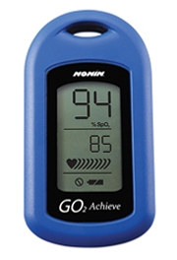
Pulse oximeters
Pulse oximeters with finger or ear probes measure the difference in absorbance of light by oxygenated & deoxygenated blood to calculate its oxygen saturation (SaO2).
Allows non-invasive continuous assessment of oxygen saturation in:
Assessing hypoxemia
Response to therapy

Slide 24
Exercise tests
Exercise measurements may be helpful in:
early disease
patients complaining only of exercise-induced symptoms.
help demonstrate exercise-induced asthma.

